Slide 1

Kazakhstan homepage
Possible to create multi-lingual versions

Slide 2
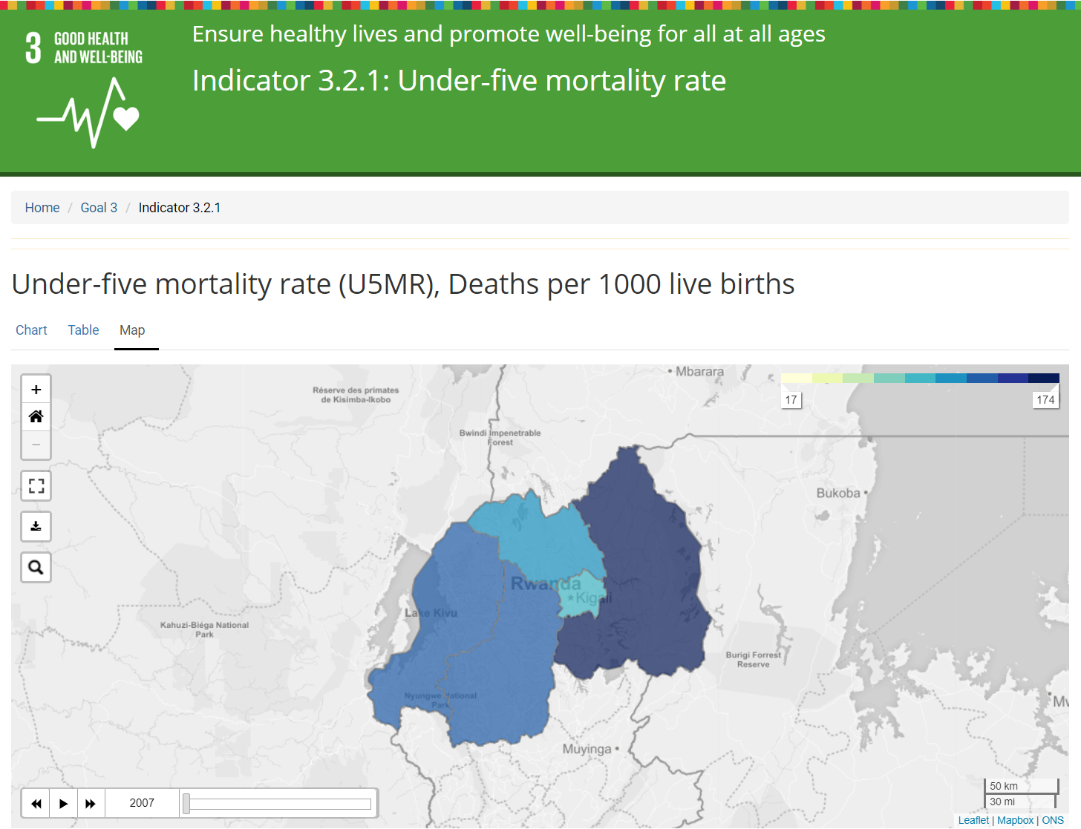
Rwanda map

Slide 3
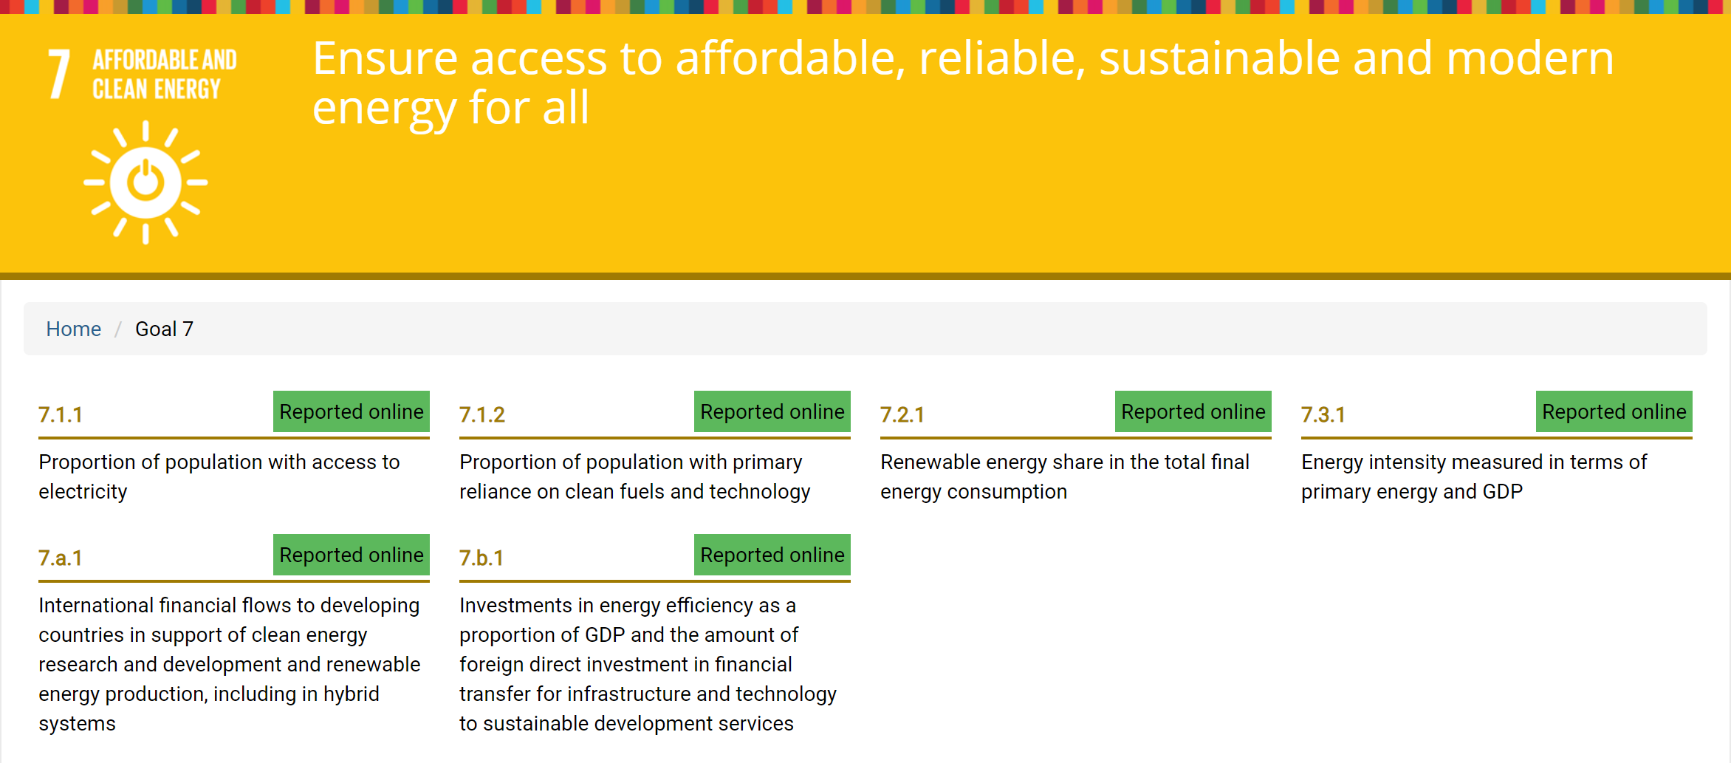
UK goal page
Just indicators

Slide 4
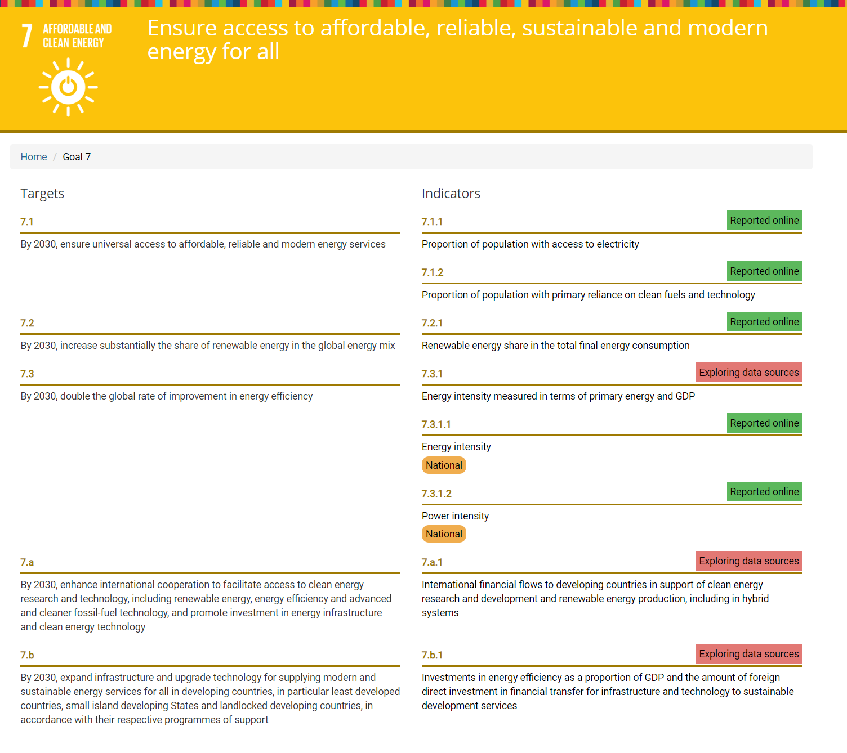
Kyrgyzstan goal page
Targets and indicators
Possible to add national SDG indicators

Slide 5
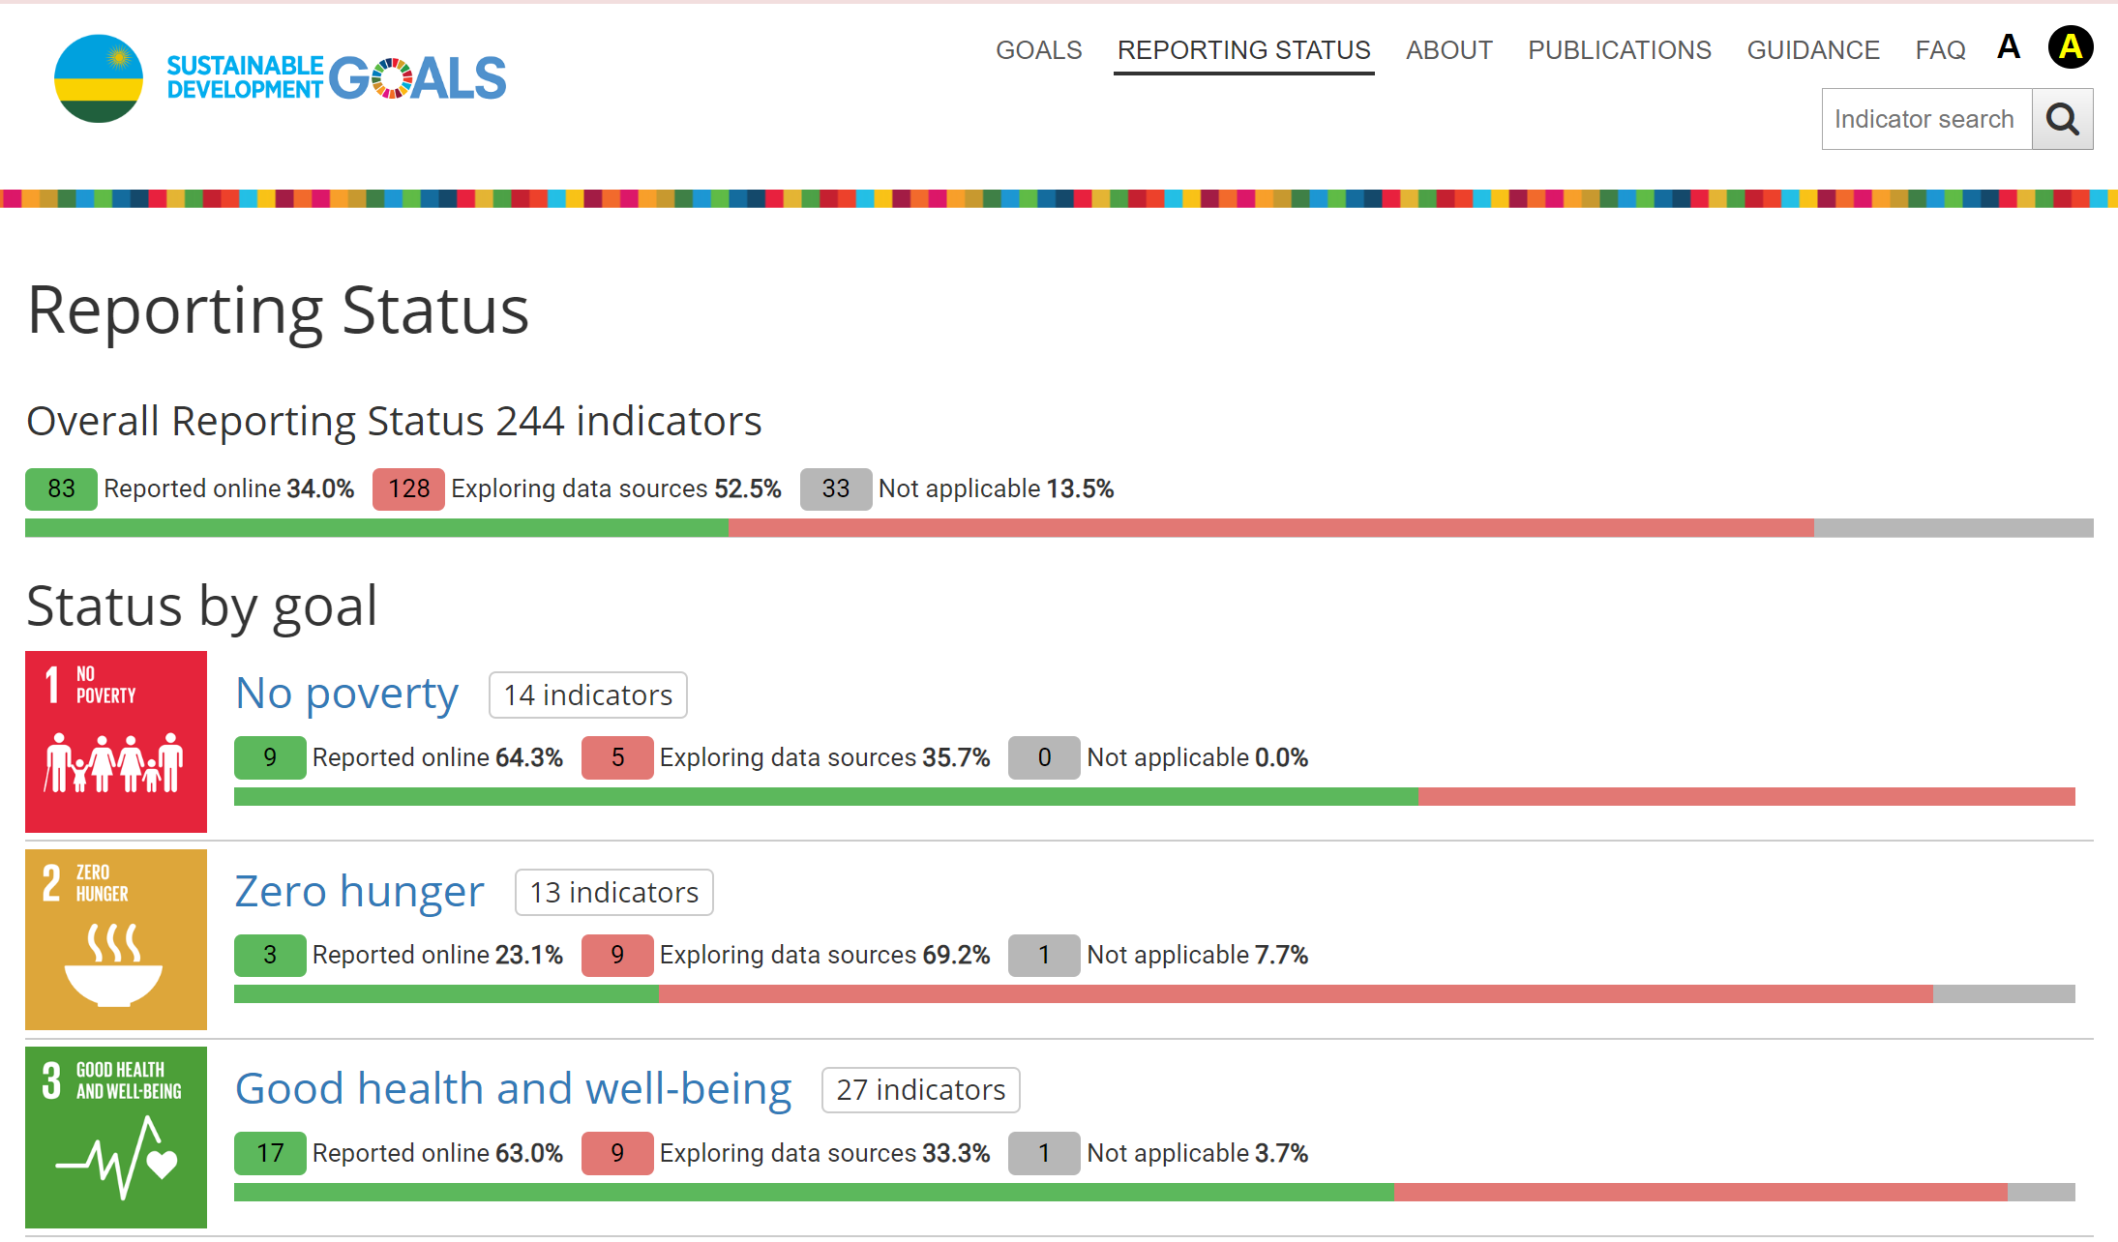
Rwanda reporting status
Can customise reporting status options

Slide 6
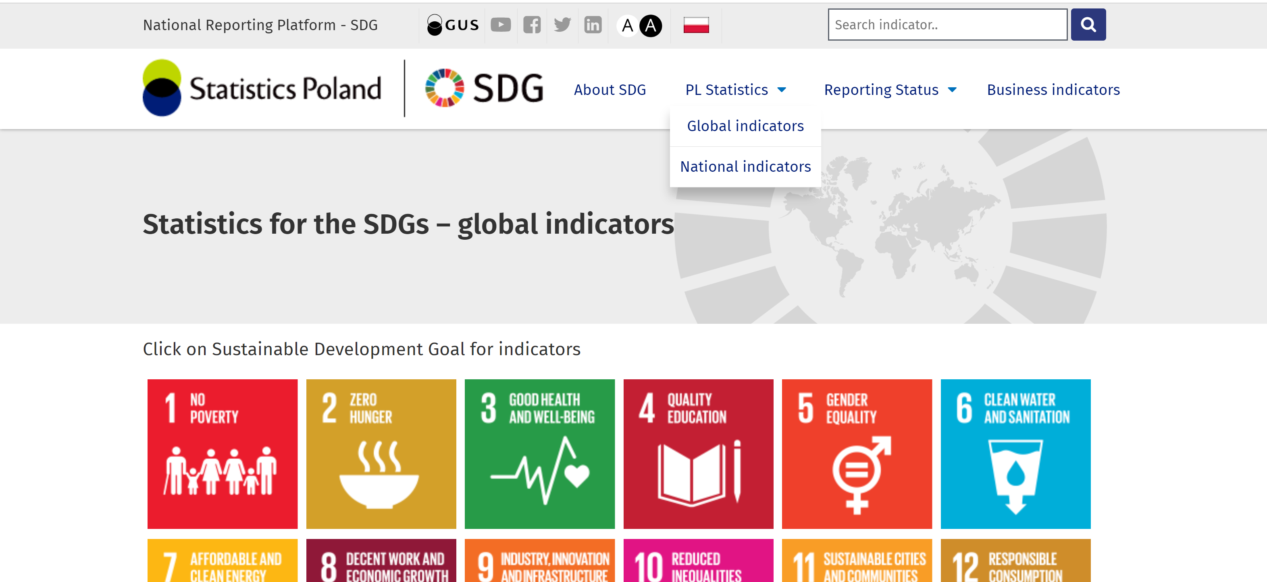
Polish platform
Have different sections for global and national indicators

Slide 7
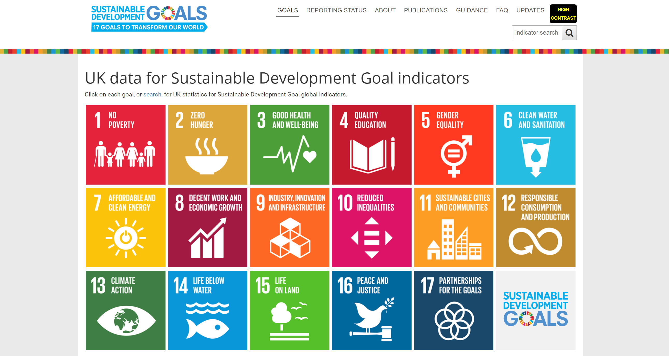
UK homepage

Slide 8
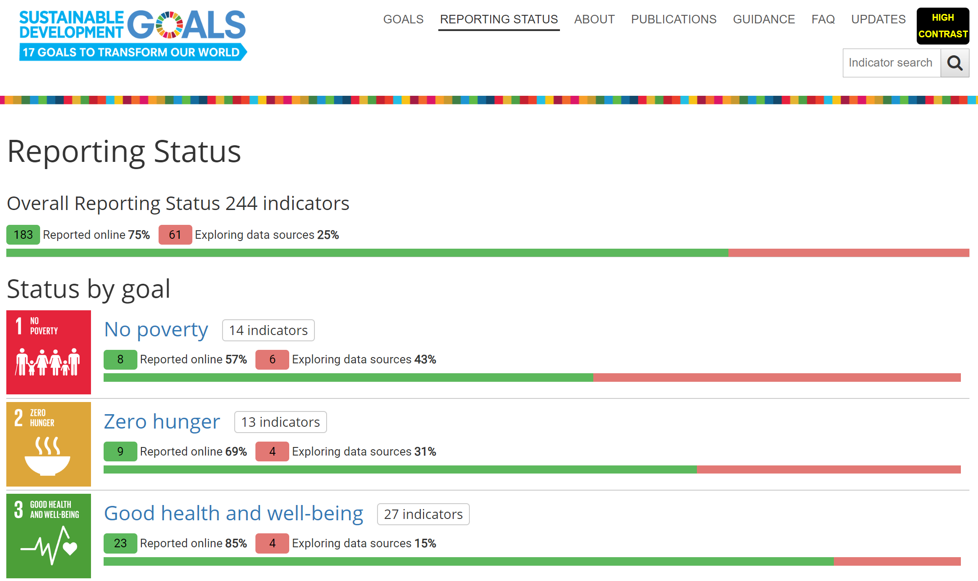
UK reporting status

